Slide 1


Presentation on E-Commerce (online shopping)
Debadrita Paul
I.T.Vedant

Slide 2
Overview
Introduction
Features
Using Languages and Tools
Feasibility
GUI-Graphical User Interface
Database Module
Future Scope
Conclusion

Slide 3
Introduction
E-commerce is the simple shopping solution. It’s full featured application and shopping cart system that bends over backwards to give you the flexibility you need to run the online store. The basic concept of the application is to allow the customers to shop virtually using the internet and allow customers to buy the home decor items of their desire from this store
Today our life is divided into two parts:
Physical Life: We met everyone physically
Virtual Life: We met people on a virtual world called ‘Internet’.

Slide 4
Features:
Menu
Catalog Browsing
Category List
Product List
Catalogue Management
Product Browsing
View Product Details
Add to cart and wish list
Shopping Cart
Check out
Address Management
Auto generated bill
Payment Gateway

Slide 5
Using Languages and Tools
Languages
Tools
HTML5
CSS3
JavaScript
Bootstrap
Djnago
Visual Studio Code
Work Bench

Slide 6
Feasibility
Technical Feasible:
Technically, this project is very feasible because of use of current and latest technology.
Financial Feasible:
Financially, It is also very feasible it made up in very low cost and will be free for all customers.
Operational Feasible:
Very easy to use.

Slide 7
GUI (Graphical User Interface)

Slide 8
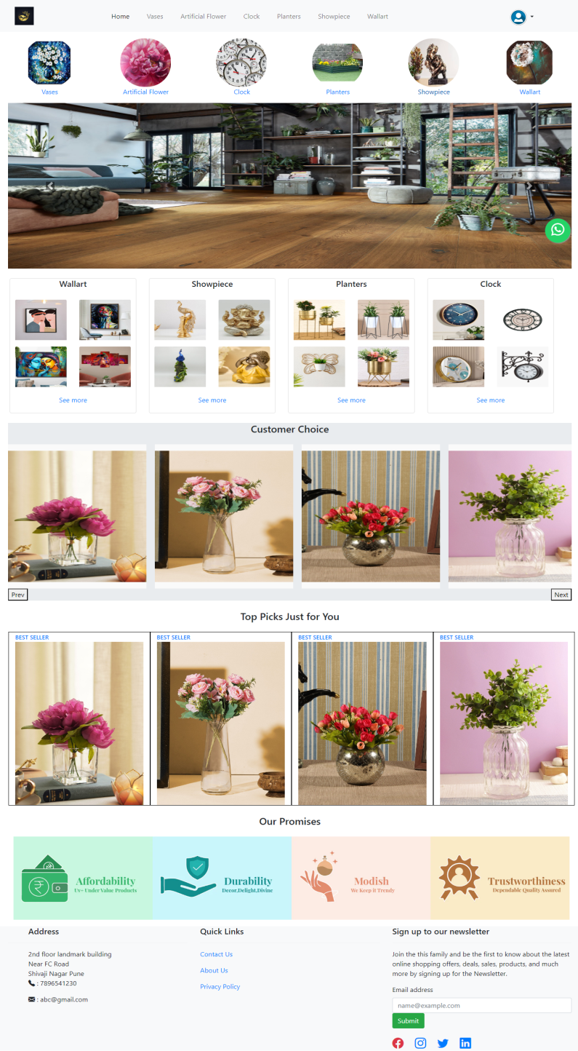
Home Page

Slide 9
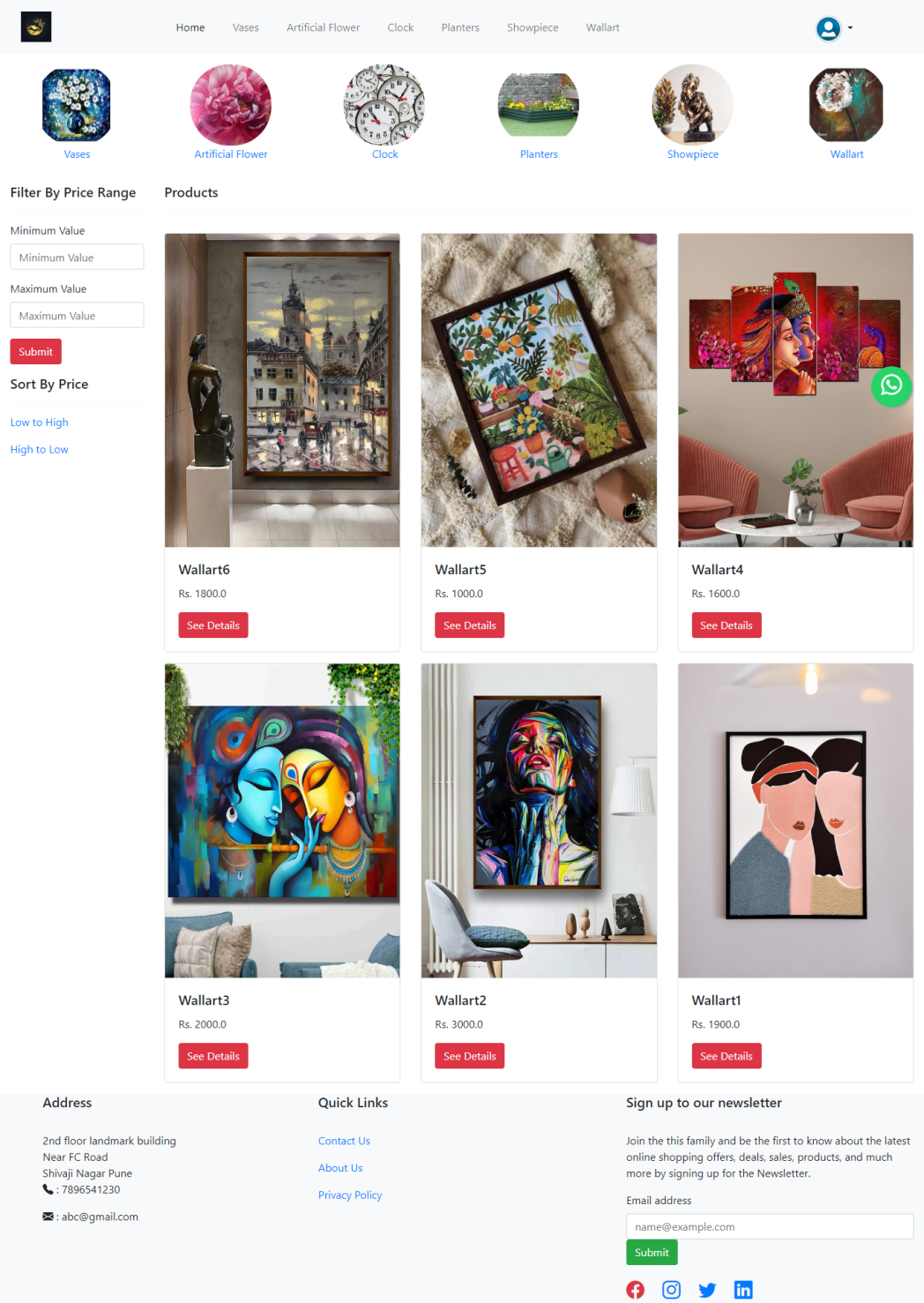
Categorized Product

Slide 10
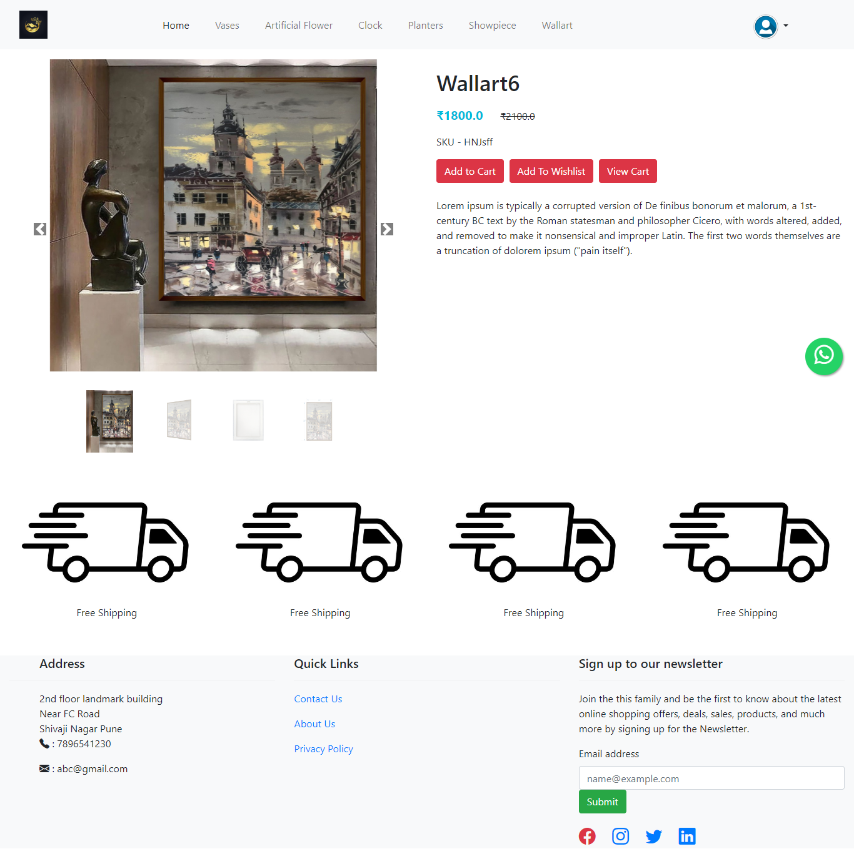
Product Details

Slide 11
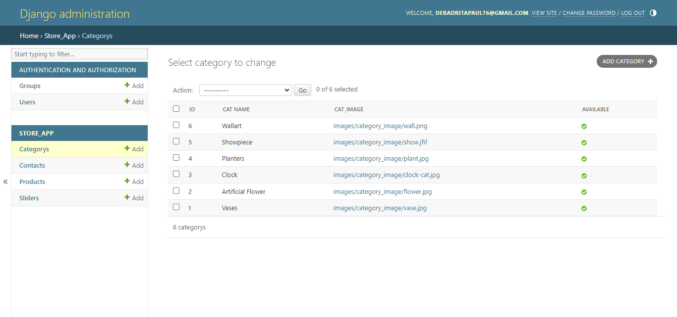
Admin Panel of show categories

Slide 12
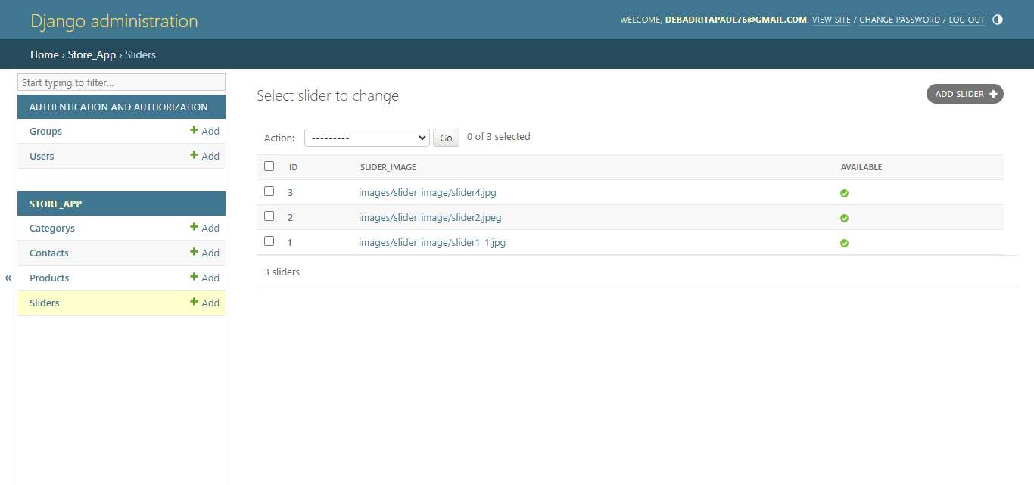
Admin Panel of show slider

Slide 13
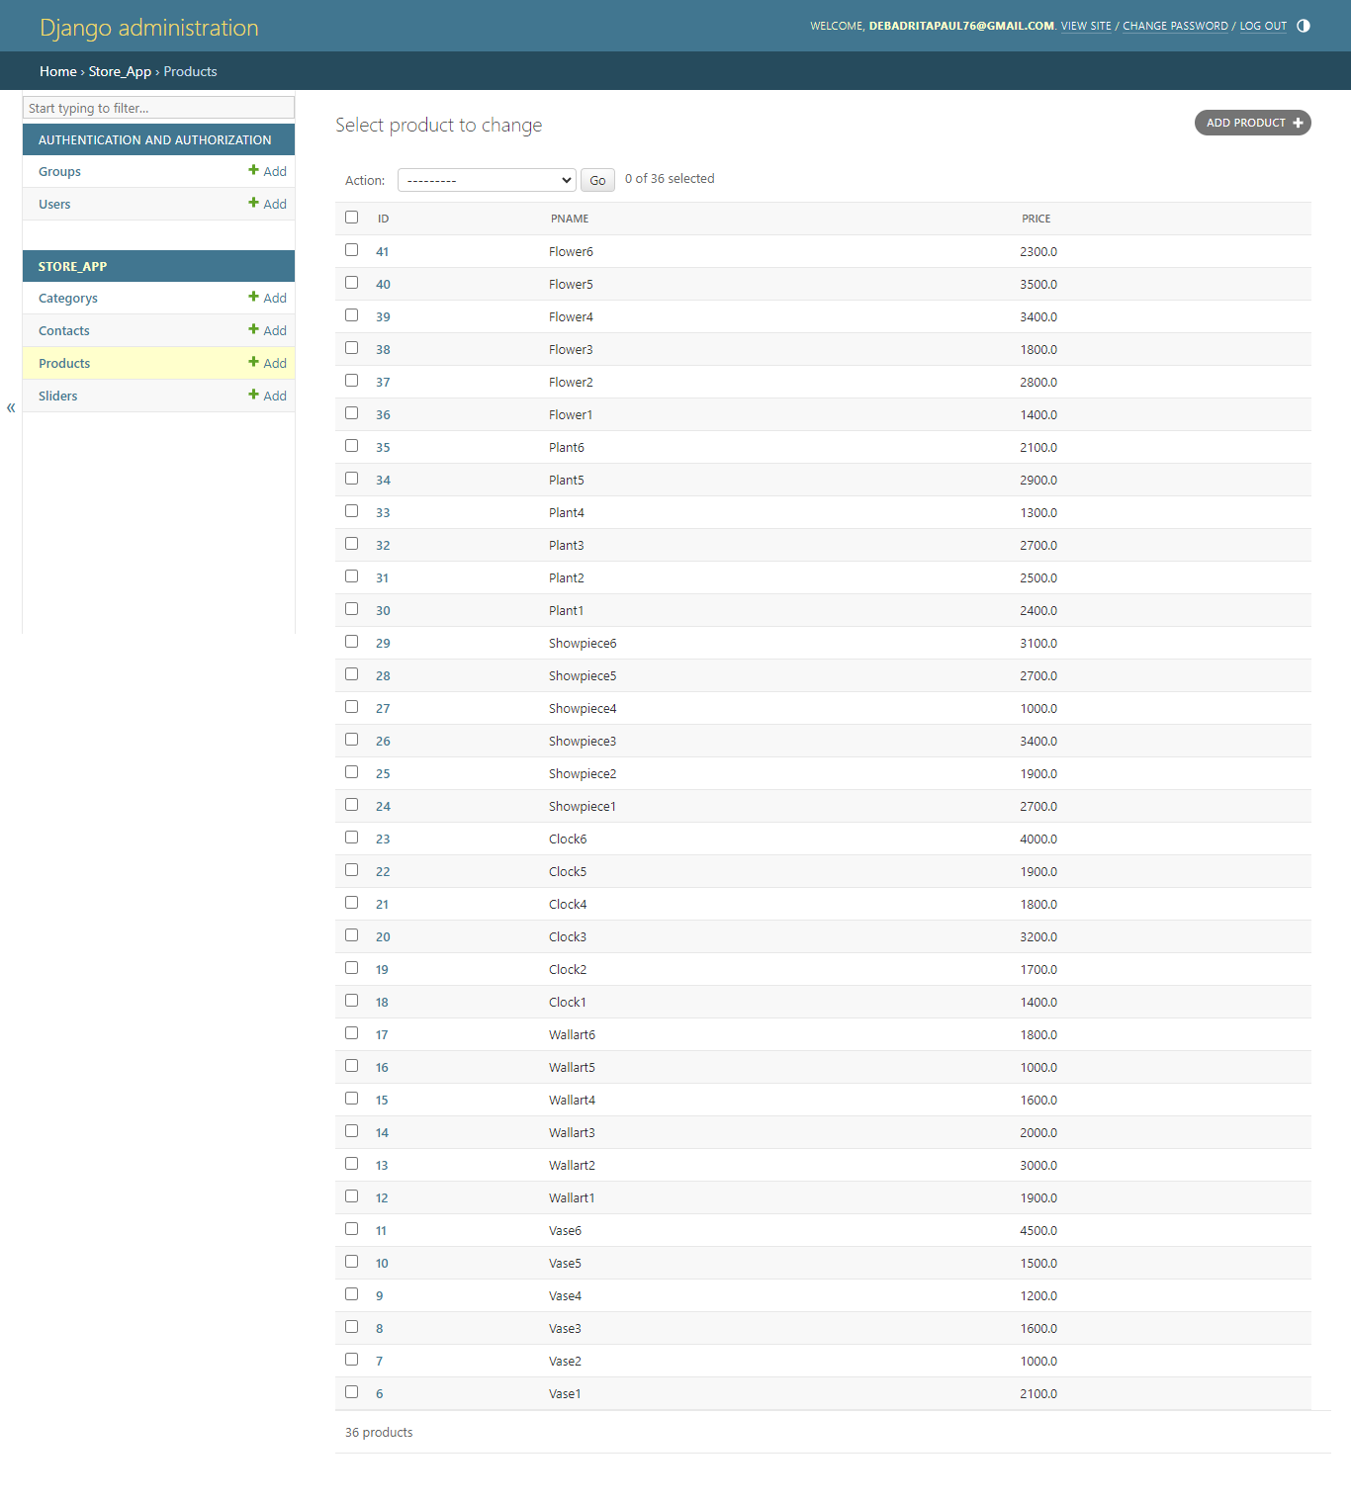
Admin Panel of show products

Slide 14
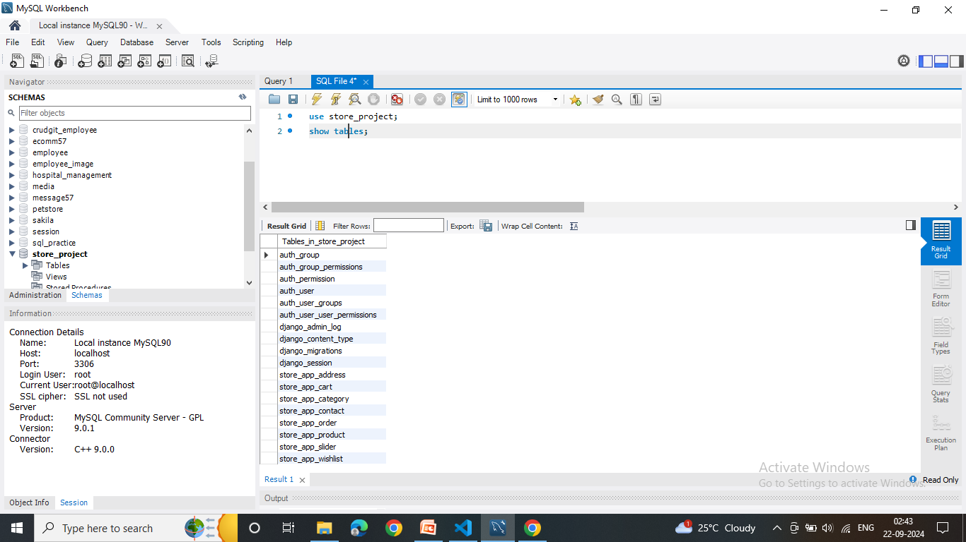
Database Module

Slide 15
Live Demo
Github Link: https://github.com/Debadrita-rgb/Home-decor

Slide 16
Future Scope
The user could subscribe for price alerts which would enable them to receive messages when price for products fall below a particular level.
User can have multiple shipping and billing information saved. During checkout can use drag and drop feature to select shipping and billing information

Slide 17
Conclusion
This project helped us in gaining valuable information and practical knowledge on several topics like HTML5,CSS3, usage of responsive bootstrap, django and management of database of MySQL. The entire system is secured. Also the projects helped us understanding about development phases of a project and software development life cycle. I’m successfully design this project with in time and all the modules are working better than my expectation.

Slide 18
Thank You

